Slide 1

Progressive Web Apps Workshop
by Logan Smith, Matthew Sheahan, Justin Folkerts & Dakota Gravitt

Slide 2




Team 4
Dakota Gravitt
Matthew Sheahan
Justin Folkerts
Logan Smith

Slide 3
Requirements
Responsive Website
Icons and images for most screen sizes
Functional Service Worker file.
Manifest JSON for offline icons and app data.

Slide 4


Technologies
Service Worker
Adjusts network requests
Handles file caching
Runs separately from main thread
Asynchronous & independent of application
Delivers push notifications
Web Manifest
JSON file
Holds data on the app
Name, author, description of app, icon directories, etc.
Tells browser how to behave when the app is installed locally on the device
Default favicon
Medium Android icon
Large icon for iOS

Slide 5
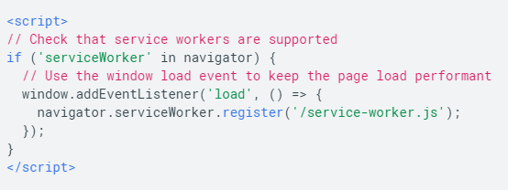
Service Worker
First things first create a Service Worker File
Then register it to your website
Create a file called service-worker.js and add a console message to the file
You can register your new service worker:
This communicates with the browser that this is the service worker to use for the site

Slide 6
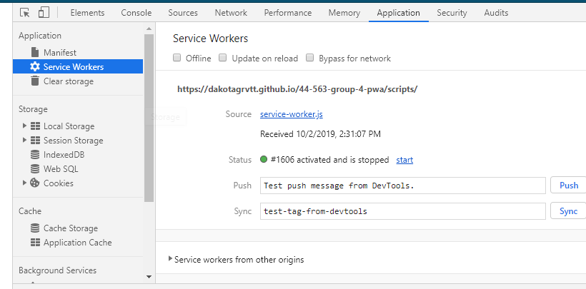
Service Worker
If you refresh your page you should see the log from the service worker file
You can now Inspect your page and in the Application tab you should see your service worker registered.
To make things easier go ahead and click the Update on Reload checkbox. This will make it easier to develop with your new service worker.

Slide 7
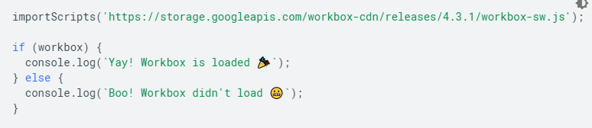
Workbox
To use Workbox we need to import the workbox-sw.js file in our service worker
Add to your service worker the following call:
Now we can play with Workbox
Workbox is a set of libraries and modules that make it easy to cache assets and take full advantage of features used to build progressive web apps.
Primary features are caching and routing modules that allow you to listen for requests from your web page and then determine how the request should be cached and responded to.
There are plenty of other modules that each offer specific behaviors that you can use in your service worker.

Slide 8
Advantages of PWA
Gives a website at least minimal offline ability
App is a more easily accessible format than a webpage
Available on both Apple and Android phones with only one app
Circumvents the store application on phones
PWAs have the ability to send push notifications to the device they're running on
Uses the Push API and the Notification API

Slide 9
Disadvantages
Some browsers don't support PWA
Impossible to monetize
Limited features compared to native phone app
Still requires internet for some functionality

Slide 10
Resources
https://developers.google.com/web/fundamentals/primers/service-workers
https://developers.google.com/web/tools/workbox
https://developers.google.com/web/fundamentals/web-app-manifest/

Slide 11
Demo
https://dakotagrvtt.github.io/44-563-group-4-pwa/

